Slide 1

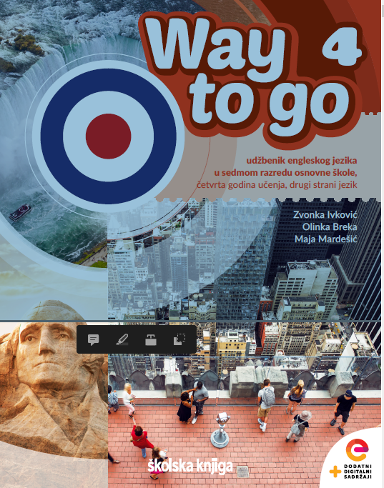
Unit 1: Lesson 1 Out of my wits

Slide 2
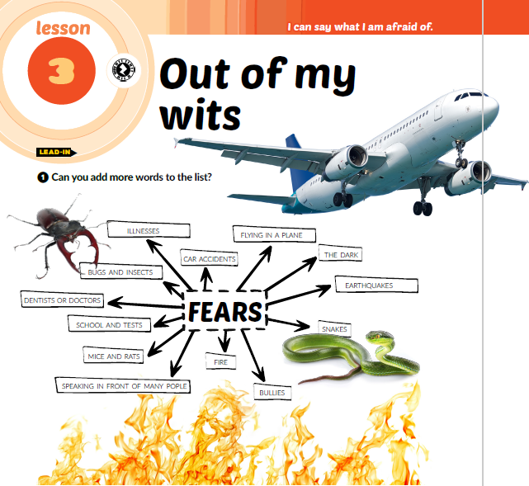
small spaces
open spaces
heights
dogs
lifts
water
horses
darkness
thunder and lightning
blood
bacteria

Slide 3
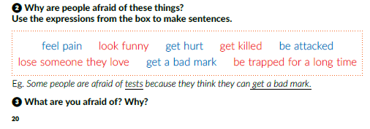

Slide 4
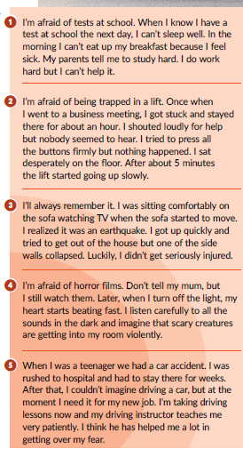
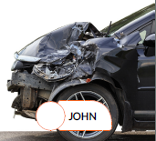
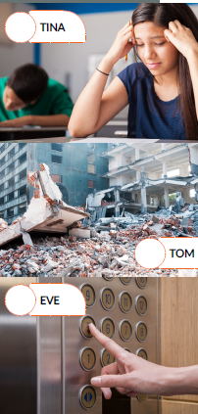
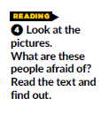
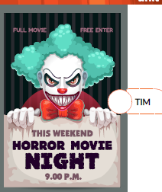
1
5
3
4
2

Slide 5

I can relate to ____________ because __________________ .

Slide 6
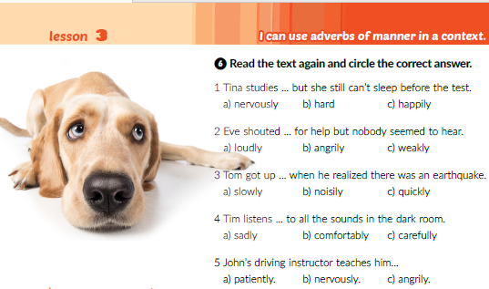

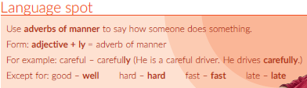

Slide 7
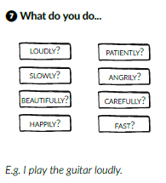

Slide 8
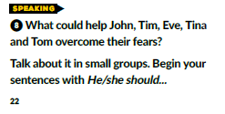

Slide 9
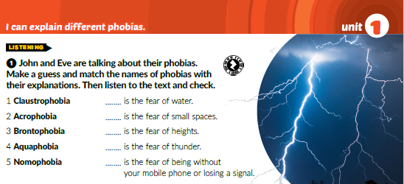
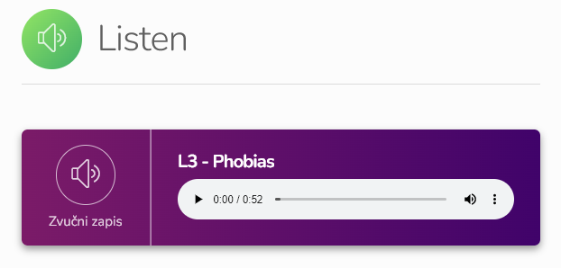
4
1
2
3
5
https://www.e-sfera.hr/dodatni-digitalni-sadrzaji/03bb596c-7493-4980-8472-24b80d7439ce/

Slide 10
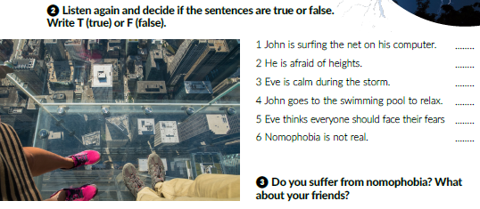
T
T
F
T
T
F

Slide 11
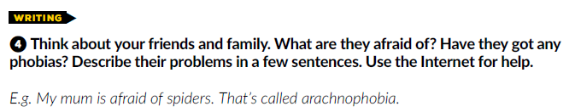
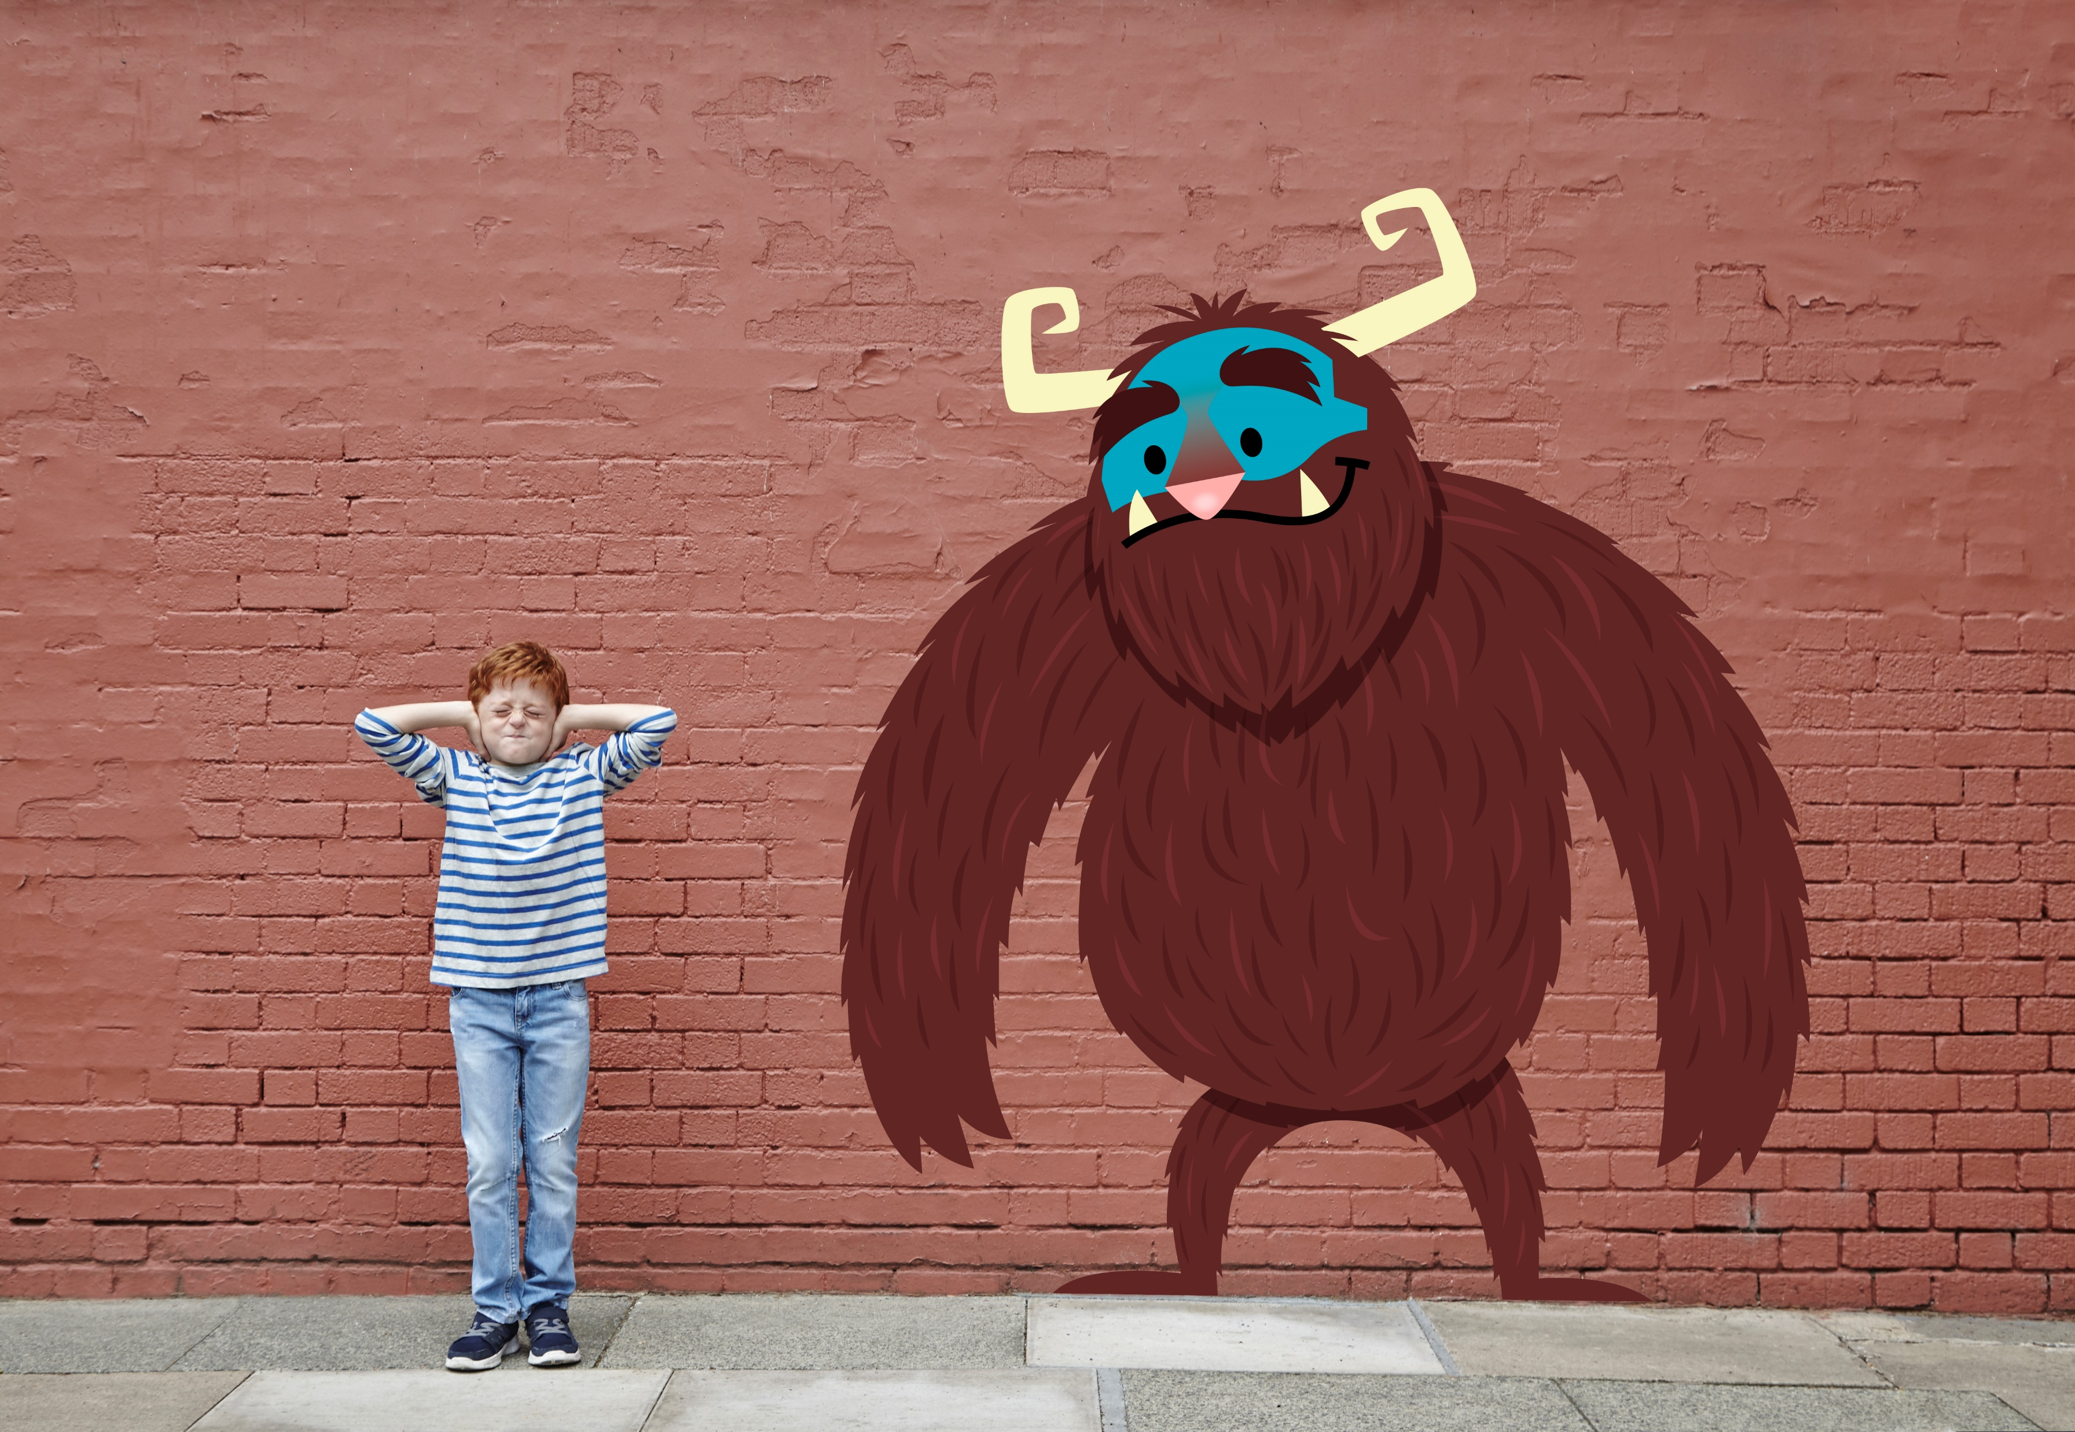

Slide 12
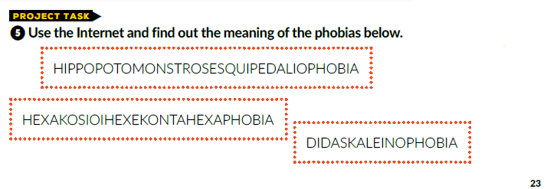
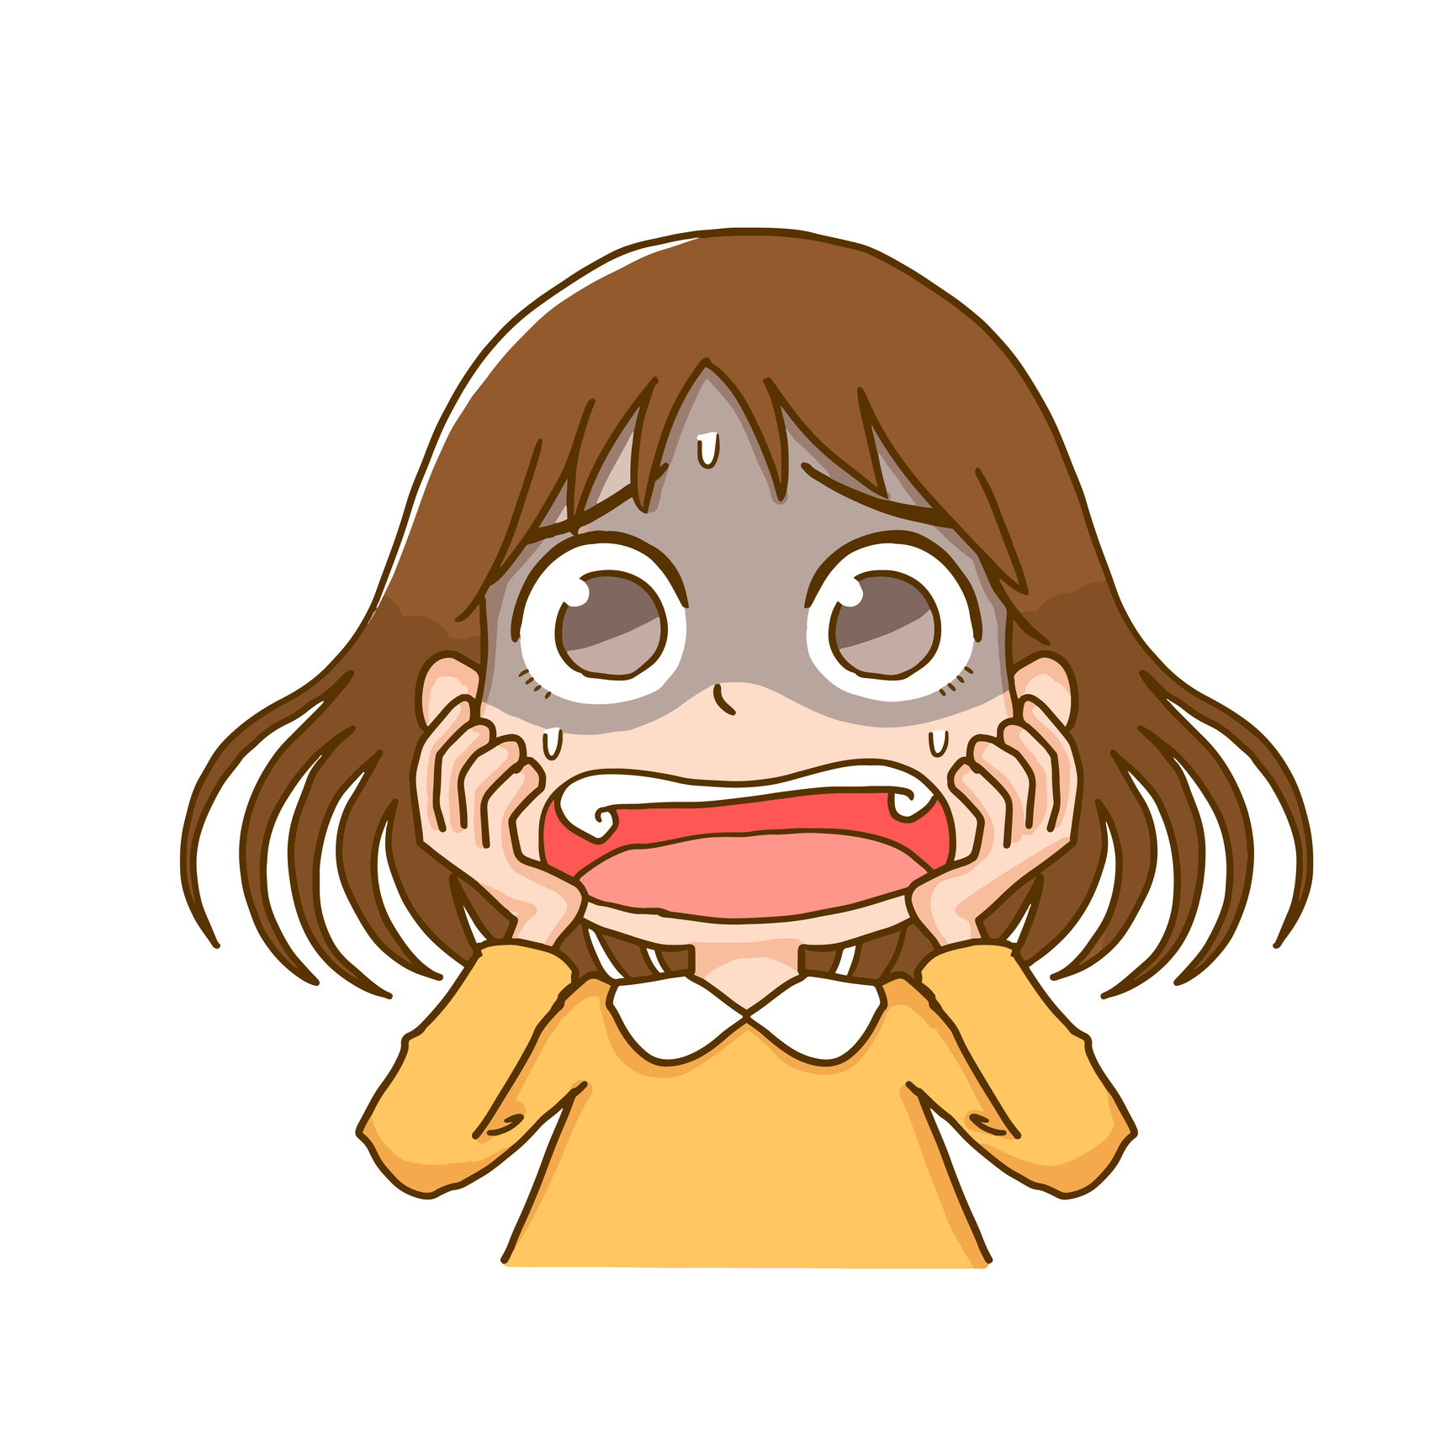
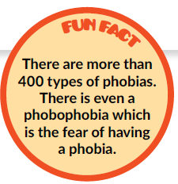
is the fear of long words
is the fear of the number 666
is the fear of going to school.

Slide 13
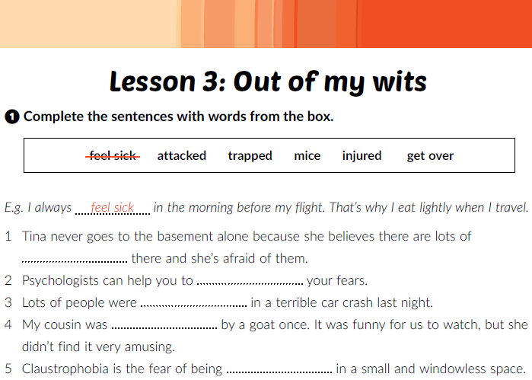
Workbook, p. 12
mice
get over
injured
attacked
trapped

Slide 14
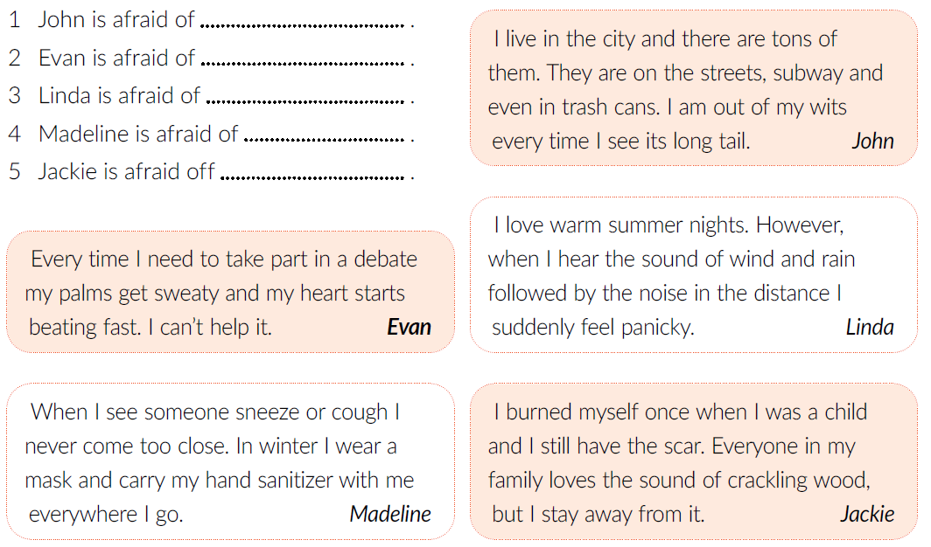
rats
public speaking
thunder and lightning
illnesses
fire

Slide 15
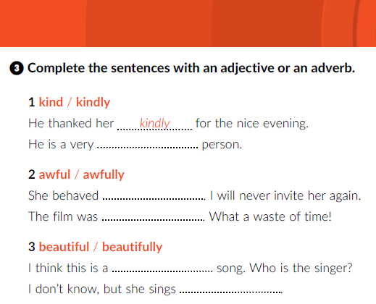
kind
awfully
awful
beautiful
beautifully

Slide 16
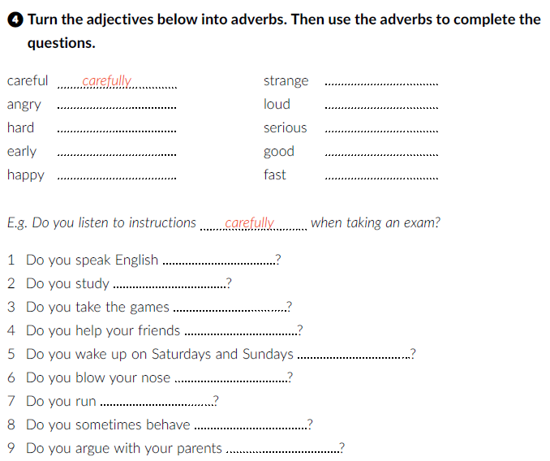
strangely
angrily
loudly
hard
seriously
early
well
happily
fast
well
hard
seriously
happily
early
loudly
fast
strangely
angrily

Slide 17
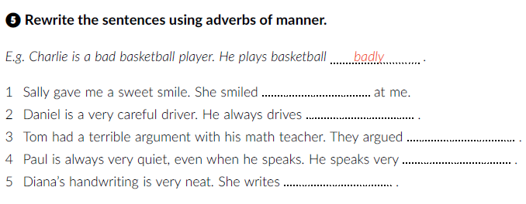
sweetly
carefully
terribly
quietly
neatly

Slide 18
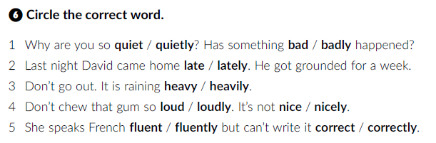


Slide 19
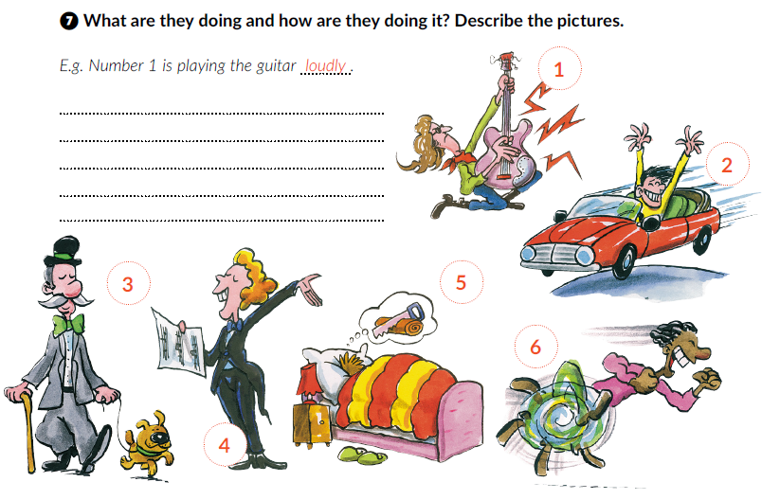
Number 2 is driving the car terribly.
Number 3 is walking the dog happily.
Number 4 is singing beautifully.
Number 5 is sleeping hard.
Number 6 is running fast.

Slide 20

Play and Learn
Lesson 3 Out of my wits | Way to go 4 (e-sfera.hr)

